Slide 1

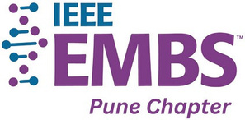




•Title name- Medinexus AI
•Problem Statement Title- Intelligent Healthcare Management System with Disease Prediction and Medical Report Analysis
•Team ID-AIML-79
•Team Name- Tech Titans
•Mentor name- Dr. Swati Shirke-Deshmukh

Slide 2
OBJECTVE
  Centralized Healthcare Management :- Develop a unified platform that connects patients, doctors, laboratories, and hospital administrators. This helps in managing healthcare services efficiently through a single system.
  AI-Based Disease Prediction :- Implement machine learning models to predict possible diseases based on patient symptoms, medical history, and health records. This supports early detection and timely medical consultation.
  Intelligent Medical Report Analysis :- Enable automated analysis of medical reports using AI and OCR technologies. The system will extract key information and provide meaningful health insights.
  Smart Hospital Services :- Facilitate appointment booking, doctor availability tracking, prescription management, bed availability monitoring, and emergency healthcare services in real time.
  Enhanced Patient Care and Accessibility :- Provide web and mobile access to healthcare services, ensuring secure medical record management, timely notifications, and improved patient engagement.

Slide 3
.
SCOPE
  The system will provide a centralized platform that connects patients, doctors, laboratories, and hospital administrators. It aims to streamline healthcare operations and improve communication among all stakeholders.
  The project includes AI-based disease prediction and medical report analysis to assist users in understanding their health conditions and seeking appropriate medical care.
  The platform will enable secure storage and access to prescriptions, laboratory reports, appointment history, and patient health records, reducing dependency on physical documents.
  The system will support appointment scheduling, doctor availability tracking, bed management, and emergency service coordination to enhance hospital efficiency.
  The solution is designed to be accessible through both web and mobile applications, ensuring convenient and real-time access to healthcare services anytime and anywhere.

Slide 4
MOTIVATION
  Many healthcare processes are still managed manually, leading to delays and inefficiencies. A digital platform can improve accessibility and streamline healthcare services.
  Existing systems often work independently, making it difficult to manage patient records, appointments, and reports in one place. An integrated solution can enhance coordination among stakeholders.
  Timely identification of diseases can improve treatment outcomes. AI-based disease prediction can assist in early diagnosis and preventive healthcare.
  Efficient management of appointments, prescriptions, reports, and hospital resources can reduce administrative workload and improve the overall healthcare experience.

Slide 5
LITERATURE SURVEY
Sr. No. | Author / Year | Technology Used | Key Findings | Research Gap
1 | Rajkomar et al. (2018) | Deep Learning, EHR | Improved disease prediction using electronic health records. | Focuses only on prediction, lacks hospital management features.
2 | Radford et al. (2022) | Whisper AI, Speech Recognition | Accurate multilingual speech-to-text processing. | Does not integrate with healthcare management systems.
3 | Xu et al. (2019) | LayoutLM, OCR | Efficient extraction of information from medical documents. | Limited support for complete medical report analysis.
4 | AI Healthcare Chatbots (2024) | NLP, Conversational AI | Improved patient interaction and healthcare assistance. | Lacks integration with patient records and hospital services.
5 | Smart Hospital Management Systems (2024) | HMS, Cloud Computing | Digitalized hospital operations and resource management. | No AI-based disease prediction or report analysis.

Slide 6
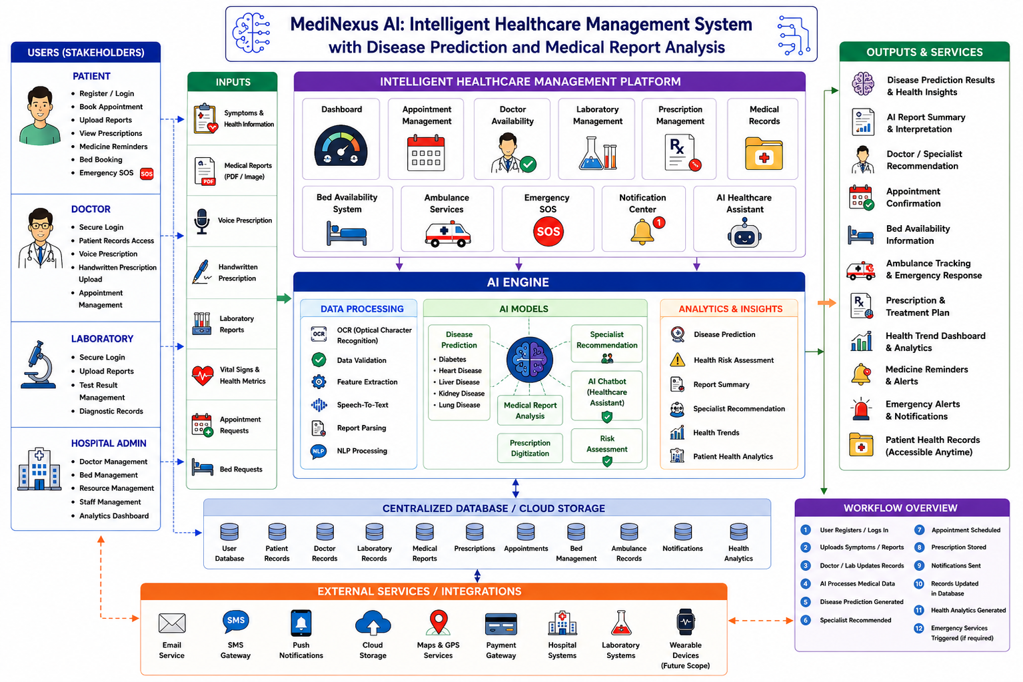
.

Slide 7
Conclusion
The proposed project, "MediNexus AI: Intelligent Healthcare Management System with Disease Prediction and Medical Report Analysis" aims to address the growing need for a centralized and intelligent healthcare platform. By integrating patients, doctors, laboratories, and hospital administrators into a single ecosystem, the system seeks to improve healthcare accessibility, streamline hospital operations, and enhance patient care. The incorporation of AI-based disease prediction and medical report analysis further enables informed decision-making and early health assessment. Overall, the project has the potential to bridge the gap between traditional healthcare management and modern AI-driven solutions, creating a smarter, more efficient, and patient-centric healthcare system.

